Slide 1

NEWEST ISSUES FOR CURRICULUM REFORM IN INDONESIA (2013)
W I D O D O
PPPPTK Matematika
Department of Education and Culture
Yogyakarta Indonesia
widodo_mathugm@yahoo.com
Presented at APEC-Tsukuba International Conference
University of Tsukuba Tokyo Japan
February 11-12, 2015
“Developing Education for Future Planning with Mathematics and Science based on the APEC Lesson Study Community”

Slide 2
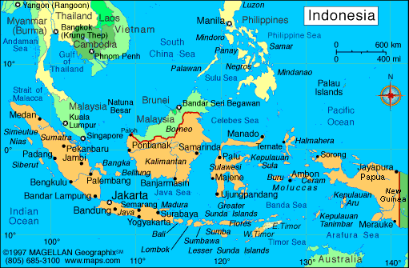

Slide 3
Curriculum Concept Reform
in Indonesia (2013)

Slide 4
Curriculum Development in Indonesia
1947
Lesson Plan → Specified in Lesson Plan Elaboration
1975
Primary School Curriculum
2004
Competence Based Curriculum (CBC) Pioneer
1968
Primary School Curriculum
1994
1994 Curriculum
2013 ‘2013 Curriculum’
1945
1955
1965
1975
1985
1995
2005
2015
1984
1984 Curriculum
2006
Unit Level of Education Curriculum (ULEC)
1973
Developmen School Pioneer Project (DSPP) Curriculum
1964
Primary School Education Plan
1997
1994 Curriculum Revision

Slide 5
CURRICULUM (2013) CHANGES IN THE FORM OF:
GRADUATES COMPETENCE
MATERIAL
PROCESS
EVALUATION
Oriented to competence characteristics:
  Attitude (Krathwohl) : Accepting + Responding + Valuing + Internalizing + Actualizing
  Skills (Dyers) : Observing + Questioning + Experimenting + Associating + Communicating+ Creating
  Knowledge (Bloom & Anderson): Knowing + Understanding + Applying + Analyzing + Evaluating + Creating
•Using Scientific Approach, Competence Characteristics based on Grades (Primary School: Integrated Thematic, Junior High School: Integrated Thematic -Science & Social Science- and Subjects, Senior High School: Thematic and Subjects
•Prioritizing on Discovery Learning and Project Based Learning
Holistic Construction
Supported By All Materials or Courses
Integrated Vertically and Horizontally
•Exam and Non-Exam (portfolio) Based
•Evaluate Process and Output using authentic assesment
•Report card contains quantitative evaluation of knowledge and qualitative descriptions of attitude and skill sufficiency
Developed Based on Competence to Fulfill Suitability and Sufficiency Aspects
Accomodate Local, National, and International Content (such as TIMMS, PISA, PIRLS)

Slide 6
Curriculum Development Framework
Psychology
Pedagogy
Socio-eco-cultural
*never stop learning
Learning
Management and Leadership
Faithful, pious, noble individual
Academic Climate and Education Unit Culture
Successful Learner
Student
Competent
Graduate
Confident Individual
Responsible Citizen
Effective Civilization Contributor
Readiness:
-Physical
-Emotional
-Intellectual
-Spiritual
Feasibility:
-Material
-Delivery Method
-Evaluation Method
Requirement:
-Individual
-Society, Nation, Country, World
-Civilization
Curriculum (SKL/Graduate competency standards, Curriculum Structure, Standards: Content, Process, and Evaluation)
Handbook
(Student Handbook, Teacher Handbook)
Teacher Competency Formulation and Teacher Preparation
Notes:
KOMENTAR dan MASUKAN:
1
2
3
4
5

Slide 7
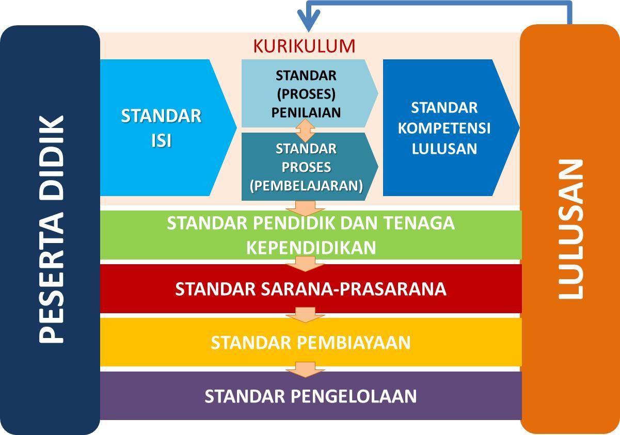
Educational Reform Refers to 8 Standards
2013 Curriculum
Curriculum
G
R
A
D
U
A
T
E
S
evaluation
process
standard
Graduation competency standards
Underway
L
E
A
R
N
E
R
Core Standards
Done and keep worked on
Learning process standard
Qualification Improvement & Certification
Certification Aid Payment
Competency Evaluation and Performance Measurement
educators standard education personnel
infrastructure standard
financing standard
management standards
School Building Rehabilitation
Laboratory and Library Supply
Book Provisioning
BOS
Poor Students Aid
BOPTN/Bidik Misi (for University)
School Based Management

Slide 8
CURRICULUM DEVELOPMENT DIMENSIONS
EDUCATIONAL PHILOSOPHIES
Perrenialism
Essentialism
Progressivism
Reconstructionism
2013 CURRICULUM PHILOSOPHY: UU Sisdiknas
Pasal 1 Butir 1 dan 2 : Education Itself: Students are actively developing their potential to have the competencies that are rooted in religious values, national culture of Indonesia and responsive to the demands of the changing times.
RPJMN 2010-2014 EDUCATIONAL SECTOR
Learning Methodology Changes
Curriculum Regulation
INPRES NOMOR 1 TAHUN 2010
Implementation of National Development Priorities Acceleration: Completion of curriculum and active learning methods based on the values of the nation's culture to shape the nation's competitiveness and character
CURRICULUM EVALUATION:
Context and Purpose Determination
Model Selection
Implementation
Curriculum Revision
CURRICULUM DEVELOPMENT THEORY: UU Sisdiknas
Pasal 4 : principles, systems, processes, culture, design, and quality control.
Pasal 3 : function (developing skills and shaping character and civilization)
Working skills-based theory → content organization and competence as an adult individual → ownership of attitudes, skills, holistic knowledge, or formal, valuational and praxeology.
No | Standard | Commentary
1. | Graduate Competency | Developed According To The Demands Of The Present And The Future Of Indonesia As Needed.
2. | Content | Parsed By The Adequacy And Suitability With Competence.
3. | Process | Designed With A Competency-based Scientific Approach
4. | Evaluation | Exam And Non-exam (Portfolio) Based
CURRICULUM BASIC STRUCTURE AND FRAMEWORK DEVELOPED UNDER THE RELEVANCE ASPECTS (Pasal 38 UU Sisdiknas)
2013 CURRICULUM (KBK): Standard Improvements : GRADUATE COMPETENCY, CONTENT, PROCESS, and EVALUATION

Slide 9
2013 CURRICULUM BOOK DEVELOPMENT STRATEGY
LESSON TEXTBOOK
SKL :
Graduate competency standards
LEARNING PROCESS
LEARNING MATERIAL
CORE COMPETENCY
EVALUATION
BASIC COMPETENCY

Slide 10
INTER-GRADE APPROACH
....... 2013 curriculum is an integrated effort of (1) reconstruction of graduate competency, with (2) suitability & sufficiency, broadness & depth of materials, (3) educational revolution and (4) evaluation reform .......
THEMATIC
+
SUBJECTS
University
Senior High School
THEMATIC
+
SUBJECTS
Junior High School
INTEGRATED
THEMATIC
+
SUBJECTS
Primary School
INTEGRATEDTHEMATIC

Slide 11
Reconstruction of Graduate Competency, Material, Process and Evaluation

Slide 12
Purpose of National Education
(Pasal 3 UU No 20 Sisdiknas Tahun 2003)
  To develop students' potential to become faithful and pious man, noble, healthy, knowledgeable, skilled, creative, independent, and also to become democratic and responsible citizen.
Spiritual Attitude | Faithful and Pious
Social Attitude | healthy, independent, democratic and responsible, etc
Knowledge | knowlegeable
Skill | skilled and creative, etc

Slide 13
Balance between attitude, skills and knowledge to develop soft skills and hard skills¹
University
Senior High School
Knowledge
Skill
Attitude
Junior High School
Primary School
Source: Marzano (1985), Bruner (1960).

Slide 14
Standard Graduate Competence Scope
and its process
Creating
Characterizing/
Actualizing
Communicating
Evaluating
Organizing/
Internalizing
Associating
Analyzing
Valuing
Experi-
menting
Applying
Responding
Questioning
Understanding
Accepting
Observing
Knowing
Attitude
(Krathwohl)
Skill
(Dyers)
Knowledge
(Bloom)

Slide 15
Learning Process that Supports Creativity
Dyers, J.H. et al [2011], Innovators DNA, Harvard Business Review:
2/3 of one’s creativity acquired from education, the other 1/3 is genetic.
The opposite is true for Intelligence: 1/3 from education, 2/3 genetic.
Creativity acquired from:
    Observing
    Questioning
    Associating
    Experimenting
    Networking
Intelligence-based learning will not have significant result (only 50% improvement) compared to creativity-based one (up to 200%)
Personal
Inter-personal
The need to formulate a curriculum based on learning process that emphasizes personal experience through the process of observing, questioning, associating, and experimenting [observation based learning] to increase students’ creativity. Moreover, students familiarized to networking through collaborative learning

Slide 16
Evaluation Process that Supports Creativity
Sharp, C. 2004. Developing young children’s creativity: what can we learn from research?:
Teacher can make students behave creatively using:
  problems which has many ways to answer,
  tolerating peculiar answers,
  emphasizing on the process rather than result,
  encourging students to try, to determine which information is unclear, to have their own interpretation of a knowledge or observed event
  balancing structured and spontaneous/expresive events
The need to formulate a curriculum containing evaluation process that emphasizes on the process and result so that portfolio-based evaluation (problem which has many answers, tolerating peculiar answers, evaluating the process together with the result, spontaneous/expressive evaluation, etc.) is needed

Slide 17
Shaping High Order Thinking Ability Since Early Stages
Center on the Developing Child, Harvard University [2011]. Building the Brain ‘ATC’ System: How Early Experiences Shape the Development of Executive Function.
The architecture of the brain is formed by layers of tissue containing neurons that are related to each other
The network is formed since early age, although it is still developing until the age of 30, the development is not as fast as children's
The complexity of the network determines the level of a person's thinking ability [low order of thinking skills for routine functions to high order of thinking skills for executive decision making functions]
It is required a learning system that can build the high order thinking skills capacity [by finding out rather than being informed] from the early ages through freedom to determine what kind of activities to do
The need to formulate curriculum that emphasizes on process observing, questioning, associating, concluding and deciding so that from early ages, students are skilled in high order thinking which will be needed for executive decision making

Slide 18
Standard Competence of Graduates
Main Competence, and Basic Competence

Slide 19
STANDARD COMPETENCE OF GRADUATES - BRIEF
DOMAIN | PRIMARY SCHOOL | JUNIOR HS | SENIOR HS
ATTITUDE | Accepting + Implementing + Respecting + Appreciating + Practicing
 | PERSON WHO HAS FAIH, NOBLE, CONFIDENT AND RESPONSIBLE IN INTERACTING EFFECTIVELY WITH SOCIAL ENVIRONMENT, THE NATURE AROUND AND THE WORLD WITH ITS CIVILISATION
SKILLS | Observing+ Asking + Experimenting + Reasoning + Presenting + Creating
 | PERSON CAPABLE OF THINKING AND FOLLOWING PRODUCTIVELY AND CREATIVELY IN THE FIELD ABSTRACT AND CONCRETE
KNOWLEDGE | Knowing + Understanding + Applying + Analyzing + Evaluating + Creating
 | PERSONAL WHO MASTERS SCIENCE, TECHNOLOGY, ARTS, CULTURE AND HUMANITY , NATIONALITY, STATE INSIGHTS, AND CIVILIZATION
Gradation between Education Unit attention;
Psychological development of children
The scope and depth of the material continuity
The function of the educational unit
4. The Environment

Slide 20
Standard Graduate Competence (SGC) - Brief
SGC |  | Main Competence
ATTITUDE AND BEHAVIOR: Accepting + Implementing + Respecting + Appreciating + Practicing |  | Appreciate and practice the teachings of their religion Develop behavior (honest, discipline, responsibility, caring, polite, environmently friendly, mutual aid, cooperation, peace-loving, responsive and pro-active) and demonstrate behaviors as part of a solution to the various problems of the nation to interact effectively with the social and natural environment and in placing itself as a reflection of the nation in the association world. Understand and apply factual knowledge, conceptual, procedural in science, technology, art, culture, and humanities with human insight, national, state, and civilization-related phenomena and events, as well as apply the procedural knowledge in a specific field of study according to their talents and interests to solve the problem. Processing, reasoning, and presenting in the realm of concrete and abstract domains associated with the development of whats is learned in school independently, and is able to use the method according to the rules of science.
Faith, morality (honest, discipline, responsibility, caring, polite), curiosity, aesthetics, confident, internal motivation Tolerance, mutual cooperation, collaboration, and consensus Healthy lifestyle, environment friendly, patriotic, and love of peace
SKILLS: Observing+ Questioning + Trying + Processing + Presenting + Reasoning + Creating
Reading, writing, counting, drawing, writing Use, parse, compose, modify, making, creating
KNOWLEDGE: Knowing + Understanding + Applying + Analyzing + Evaluating
Science, technology, art, and culture Humans, nation, state, country, and world

Slide 21
Competency linkages between levels of education
KI
Kelas VI
Aim of National Education
KI
Kelas VI
Formulation Process
GC
UNIV
VERTICAL INTEGRATION
KI
Kelas V
KI
Kelas V
GC
SHS/VS/MA
KI
Kelas IV
KI
Kelas IV
GC
JHS/MTs
KI
Kelas IIII
KI
Kelas IIII
GC
PS/MI
Mata Pelajaran
Mata Pelajaran
Mata Pelajaran
Mata Pelajaran
Core Competence Set
Mata Pelajaran
Mata Pelajaran
Mata Pelajaran
Mata Pelajaran
Mata Pelajaran
Mata Pelajaran
Formation Process
Basic Competence Set
Mata Pelajaran
Mata Pelajaran
Mata Pelajaran
Mata Pelajaran
Mata Pelajaran
HoriZonta
Integration
Mata Pelajaran
Subject
GC: Graduate Competence

Slide 22
The Linkage between graduate compotence, core competence and subjects for primary school
KI
Kelas VI
Kompetensi
Lulusan
KI
Kelas VI
Kompetensi
Lulusan
KI
Kelas VI
GC
Grade VI
KI
Kelas V
Graduate Competence
FORMULATION PROCESS
KI
Kelas V
Vertical Integration
KI
Kelas V
GC
Grade V
KI
Kelas IV
KI
Kelas IV
KI
Kelas IV
GC
Kelas IV
KI
Kelas IIII
KI
Kelas IIII
KI
Kelas IIII
GC
Grade IIII
KI
Kelas II
KI
Kelas II
KI
Kelas II
GC
Grade II
KI
Kelas I
KI
Kelas I
KI
Kelas I
GC
Grade I
Mata Pelajaran
Mata Pelajaran
Mata Pelajaran
Mata Pelajaran
Mata Pelajaran
Mata Pelajaran
Formation Process
CORE COMPETENCE SET
Mata Pelajaran
Mata Pelajaran
Mata Pelajaran
Mata Pelajaran
Mata Pelajaran
Mata Pelajaran
Horizontal Integration
Subject
GC: Graduate Competence

Slide 23
STANDARD COMPETENCE PRIMARY SCHOOL GRADUATES BASED ON 2013 CURRICULUM
Attitude | Have [through receiving, implementing, cherishing, appreciating, practicing] behavior that reflects the attitude of the faithful, noble character [to be honest, polite, caring, disciplined, democratic], confident, and responsible for interacting effectively with the social and natural environment, around the home, school, and play area
Skills | Have [through observing, asking, trying, processing, presenting, reasoning, creating] the ability of thinking and act productively and creatively in the realm of the abstract and the concrete in accordance with that assigned to him.
Knowledge | MHave [through knowing, understanding, applying, analyzing, evaluating] factual and conceptual knowledge based on curiosity about science, technology, art, and culture in human insight, national, state, and civilization-related phenomena and events in the home, school , and playground

Slide 24
STANDARD COMPETENCE JUNIOR HIGH SCHOOL GRADUATES BASED ON 2013 CURRICULUM
Attitude | Have [through receiving, implementing, respect, appreciate, practice] behavior that reflects the attitude of the faithful, noble [honest, polite, caring, disciplined, democratic], confident, and responsible to interact effectively with the social and natural environment in range interaction
Skill | Have [through observing, asking, trying, processing, presenting, reasoning, creating] the ability of thinking and effectively and creatively in the realm of the abstract and the concrete in accordance with what is learned in school and other similar sources
Knowledge | Have [through knowing, understanding, applying, analyzing, evaluating] factual knowledge, conceptual, and procedural based on curiosity about science, technology, art, culture in human insight, national, state, and civilization-related phenomena and events that can be seen with our eyes

Slide 25
STANDARD COMPETENCE SENIOR HIGH SCHOOL GRADUATES BASED ON 2013 CURRICULUM
Attitude | Have [through receiving, implementing, respecting, appreciating, practicing] behavior that reflects the attitude of the faithful, noble [honest, polite, caring, disciplined, democratic, patriotic], confident, and responsible to interact effectively with the social environment and nature as well as in established itself as a reflection of the nation in the world’s association
Skill | Have [through observing, asking, trying, processing, presenting, reasoning, creating] the ability of thinking and act effectivly and creatively in the realm of the abstract and concrete as the development of the independently studied in school [in a specific field of study] according to their talents and interests
Knowledge | Have [through knowing, understanding, applying, analyzing, evaluating] procedural and metacognitive knowledge based on curiosity about science, technology, art, culture in human insight, national, state, and civilization-related causes of phenomena and events [in the specific field of study ] according to their talents and interests

Slide 26
STANDARD COMPETENCE VOCATIONAL SCHOOL GRADUATES BASED ON 2013 CURRICULUM
Attitude | Have [through receiving, implementing, respecting, appreciating, practicing] behavior that reflects the attitude of the faithful, noble [honest, polite, caring, disciplined, democratic, patriotic], confident, and responsible to interact effectively with the social environment and nature as well as in established itself as a reflection of the nation in the world’s association
Skills | Have [through observing, asking, trying, processing, presenting, reasoning, creating] the ability of thought and act effectively and creatively in the realm of the abstract and concrete as the development of the independently studied in school [in specific work areas] in accordance with their talents and interests
Knowledge | Have [through knowing, understanding, applying, analyzing, evaluating] procedural and metacognitive knowledge in science, technology, art, culture with human insight, national, state, and civilization-related causes of phenomena and events [in specific work areas] in accordance talent and interest

Slide 27
Content Mapping

Slide 28
Mathematics
No | Previous Curriculum | Current Curriculum
1 | Go directly to abstract material | Starting from the observation of concrete problems, then to the semi-concrete, and finally abstraction problem
2 | Many formulas to be memorized to resolve the problem (can only be use) | The formula derived by the students and the issues proposed must be workable for students with only formulas and basic understanding (not only use but also to understand its origin)
3 | Mathematical problems were associated with the [reduced to] numbers | Balance between math with numbers and without numbers [images, graphics, patterns, etc.]
4 | Not accustom students to think critically [only mechanistic] | Designed so that students must think critically to solve the problems posed
5 | Unstructured method of problem solving | Accostuming students to algorithmic thinking
6 | Data and statistics introduced in class IX only | Extending material includes opportunities, data processing, and statistics from class VII and other materials in accordance with international standards
7 | Mathematics is exact | Introduce the concept of the approach and estimates

Slide 29


Problem 1: Given the sequence of pictures:
If = 1, then
(a). How many squares in the 1st picture
(b). How many squares in the 2nd picture
(c). How many squares in the 3rd pucture
(d). How many squares in the 4th picture
(e). How many squares in the 5th picture
(f). How many squares in the n th picture

Slide 30

Problem 2: Given the sequence of pictures:
If = 1, then
(a). How many squares in the 1st picture
(b). How many squares in the 2nd picture
(c). How many squares in the 3rd pucture
(d). How many squares in the 4th picture
(e). How many squares in the 5th picture
(f). How many squares in the n th picture

Slide 31

Problem 3: Given the sequence of pictures:
If = 1, then
(a). How many squares in the 1st picture
(b). How many squares in the 2nd picture
(c). How many squares in the 3rd pucture
(d). How many squares in the 4th picture
(e). How many squares in the 5th picture
(f). How many squares in the n th picture

Slide 32
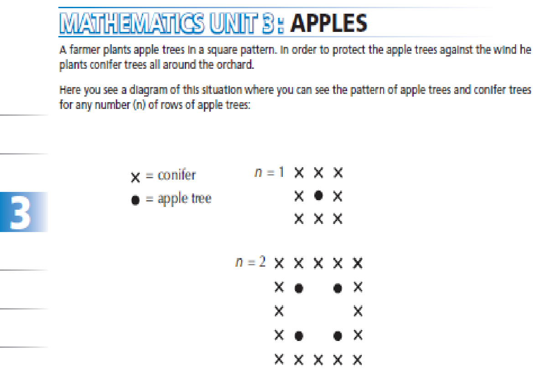
Pattern Finding Problem

Slide 33
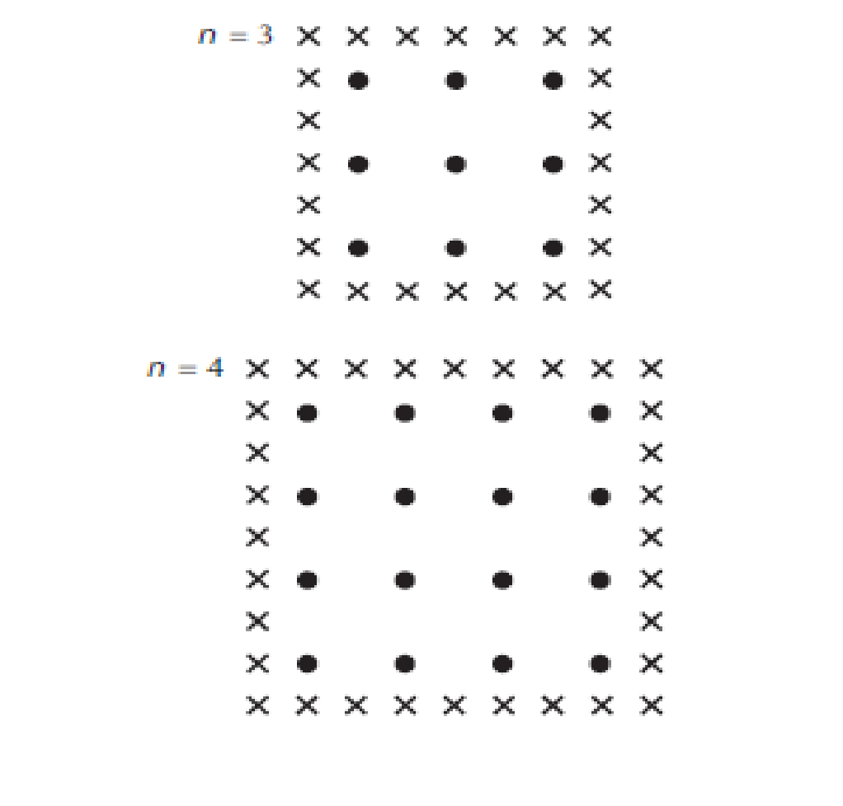

Slide 34
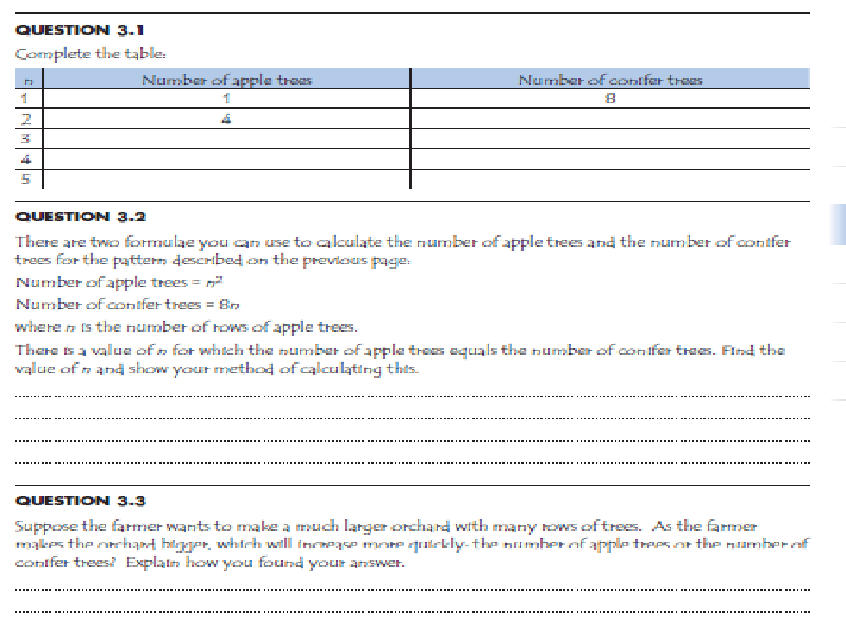

Slide 35
Broad context estimation

Slide 36
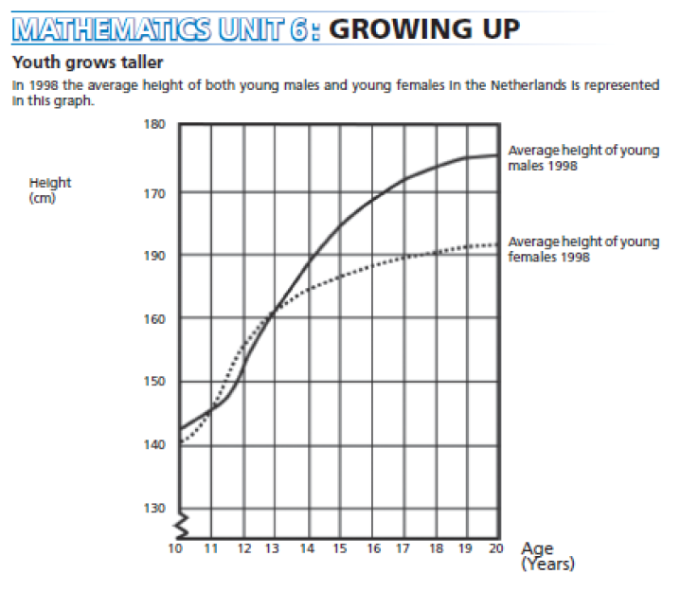
Answers obtained from the graph context

Slide 37
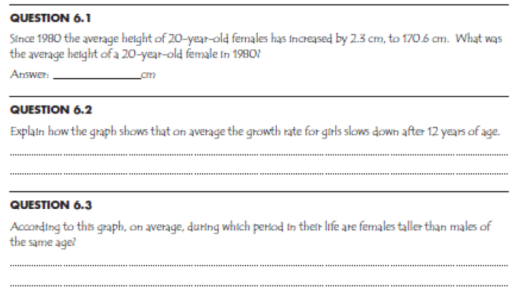

Slide 38
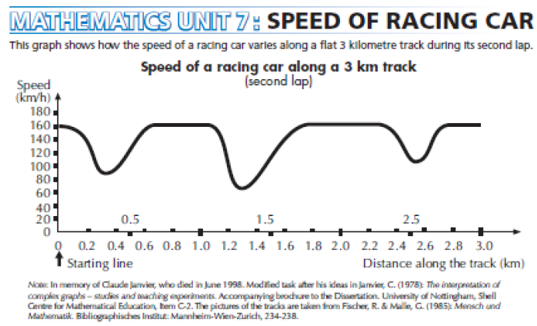

Slide 39
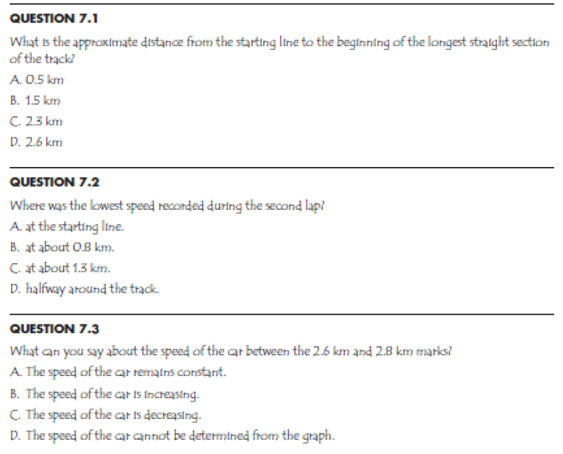

Slide 40
Science
No | Previous Curriculum | Current Curriculum
1 | The learning material is presented separately in Physics, Chemistry, and Biology | The learning material is presented integrated , no more separation between Physics, Chemistry, and Biology
2 | No platform, all studies stand in line | Use Biology as a study platform with consideration of all natural events and phenomena associated with the objects and their interactions among these objects. The goal is to emphasize the importance of interaction of biology, physics, chemistry and their combinations in forming a stable bond.
3 | Earth and space science materials is still inadequate [partly discussed in Social] | Completed with earth and space science materials in accordance with international standards
4 | The material tend to be superficial and memorizable | The material enriched with the needs of students to think critically and analytically in accordance with international standards
5 | Learning materials were taught by different teachers (team teaching) with certification based on the subject. | Learning materials are taught by a teacher who gives an insight into the integrated subject area so that students can understand the importance of integration between subjects before studying them in detail separately in the next education level

Slide 41
Indonesian/English Language
No | Previous Curriculum | Current Curriculum
1 | Learning material was focused on grammar | Learning material is focused on language competence as a media of communication to convey idea and knowledge
2 | Students were not accustomed to read and understand the meaning of the text presented | Students are accustomed to read and understand the meaning of the text as well as summarizing and presenting again with its own language
3 | Students were not accustomed to compose a systematic, logical, and effective text | Students are accustomed to compose systematic, logical, and effective text through exercises
4 | Students are not introduced on the rules of text for the real needs | Students are introduced to the appropriate text rules so as not to confuse in writing a text (according to the situation: who, what, where)
5 | Less emphasis on the importance of language expression and spontaneity | Students are accustomed to express himself and his knowledge using convincing language spontaneously

Slide 42
Social Science
No | Previous Curriculum | Current Curriculum
1 | The material is presented separately in Geography, History, Economics, Sociology | Material presented in integrated, not separated into groups of Geography, History, Economics, Sociology.
2 | No platform, all studies stand in line | Geography is used as the study platform by considering that all events and activities are tied to the location. The goal is to emphasize the importance of the unity in strengthening the National Republic of Indonesia. The study history, sociology, culture, and economics are meant to support the formation of the stronger unity.
3 | Learning materials was taught by different teachers (team teaching) with certification based on the subject. | Learning materials are taught by a teacher who gives an integrated insight between subjects so that students can understand the importance of the integration, before learning it in detail and separately in the next education level.

Slide 43
Pancasila and Civics
No | Previous Curriculum | Current Curriculum
1 | Learning materials were presented based on four separated pillars. | Learning materials are not presented based on the four pillars of nationality grouping but based on the integration of the four pillars in forming the national character
2 | Learning materials were presented based on the existing supply on the four pillars of nationality. | Learning materials are presented based on the need to be a responsible citizen (obey the norms, principles, and rules)
3 | There was no emphasis on action as a good citizen | existence of competence required from students to take real action as a good citizen
4 | Pancasila (Five principles) dan civics was presented as a knowledge to memorize | Pancasila (Five principles) dan civics is not merely a memorizable knowledge but applied in the real action and daily life.

Slide 44
General Book Concept on Curriculum 2013
Referring to the core competencies that have been formulated for the intended class
Explaining knowledge as an input to the students to produce an output in the form of student skills and end with forming the students attitudes as learning outcomes
Using a scientific approach through observing, asking, trying, reasoning, and presenting
Encourage students to find a concept being learnt deductively [discovery learning]. Students are encouraged as much as possible to find out, not directly informed
Covering the assessment of learning outcomes gradually from the review, exercise, the problem, challenge, and project.
Emphasizing the use of clear, logical and systematic language.
Skills are not always in the area of abstract, but also must be concrete in the form of real action

Slide 45
Examples of Core Competence Grade Primary School
Area of Competence | Core Competence
Spiritual Attitude | Accepting and applying the religion they believe.
Social Attitude | Having behavior of honest, discipline, responsible, polite, caring, and confident in interacting with family, friends, and teachers.
Knowledge | Understanding the factual knowledge by observing [listening, seeing, reading] and asking based on curiosity about himself, God's creation and its activities, and the objects he encountered at home and in school
Skill | Presenting factual knowledge in clear and logical, in the form of aesthetic work, the movement reflecting a healthy child, and the actions reflecting the behavior of the faithful, noble, and knowledgeable child.

Slide 46
Primary School Books
Thematic integrative books
Activity –based, covering daily activities planning
Students worksheet (at the end of theme will be the students’ portfolio)
Each series of learning (sub-themes) begins with a stimulus to observe and ask about the surroundings in line with sub-themes being discussed (arranged in the form of clear, logical, and systematic text )
In the next step, begins with learning the clear language text [written / oral] in accordance with sub-themes and materials that will be discussed
The first grader is supposed to be ready with reading, writing and counting
Accustomed to observe the pattern (numeric and forms) and understanding the rules in forming them
Language understanding should be prioritisized than the other material
Knowledge is being a topic in understanding language, thus students easily understand both language and knowledge.
Showing the importance of data and its presentation.
Mathematics is not always link to numeric and counting
Sport dan art, culture, skill correspond to the discussed materials (math, science and others)
Skills should also be in concrete actions not just an abstract
Each theme should be ended with project

Slide 47
Junior High School Books on Curriculum 2013
No | Curriculum 2013
1 | Each subject supports all competences [attitude, skill, knowledge)
2 | Subject is designed interrelated one another and having the basic competence tied with core competence in each class.
3 | All subjects are taught using the same approach; scientific approach through observing, asking, trying and thinking.
4 | Students’ assignment is related to the students’ skill
5 | Prioritizes the discussion based on themes
6 | ICT is a tool of learning, used as the learning media for all subjects.

Slide 48
MP | Junior High School Curriculum Concept
Social Science | Learning materials are presented an integrated, not separated into groups of Geography, History, Economics, Sociology. Geography is used as a platform to demonstrate the diversity to form connectivity linking supply and demand. Discussion is based on the kinds of resources for development. Geology is not part of social science
Science | Learning materials are presented an integrated, not separated in physics, chemistry, biology. Biology is used as a platform to describe other disciplines. Referring to international standards (PISA, TIMSS) both based on its broad and depth, Science covers earth and space sciences. The discussion is based on the basic principles of life in the universe [interaction, energy, transformation, etc.]. Avoiding calculation [the formula], emphasizing mastery of concepts and experiments.
Mathematics | Referring to international standards (PISA, TIMSS,) both its broad and dept, starting with concrete problems gradually brought into the form of an abstract (model). Emphasizing the importance of the procedure [algorithm] in problem solving. Covering the numbers, algebra, form, data and chances in balance; it is not always exact, can be approximate; and not always have complete information to be completed
Indonesia Language | Referring to international standards (PIRL,); Text-based, balanced between written and oral. Emphasizing the importance of language as a communication tool to convey ideas and knowledge. Master the competencies about text: composing [by understanding of the rules, structure, and context], distinguishing, judging, editing, capturing meaning, summarizing, representing using his own language; emphasizing expression and spontaneity in speaking while knowledge is as the content.
48

Slide 49
MP | Junior High School Curriculum Concept
Civics | Presented integrated, not based on the four pillars of nationality grouping but based on the integration of the four pillars in forming the nation character. The material is presented based on the need to become a responsible citizen (obey norms, principles, and rules); students are required to have competence in taking real action as a good citizen [actively involved in the development of society].
Englis | Designed in the same way as Indonesia language with the emphasis on Indonesian ditto with an emphasis on conversation, reading, writing practices. Assuming that the students have not been formally studied English at the time of grade VII entry.
Art and Culture | Students are given the knowledge and basic techniques mastery, thus they will be fond of art and culture to increase the sensitivity and appreciation to the art and culture product and value. Understanding the diversity and uniqueness of every aspect of the art in order to feel the beauty of the product and the value of art and culture.
Skill | Students are equipped with enough knowledge about materials, processes, and tools along with the resources necessary to produce a masterpiece. Applying this knowledge to be skilled in working with an effective and efficient manner by analyzing the materials, processes, and tools required
Sports | The integration between physical education, sports, and health. Not only skill, but there must be an underlying knowledge, and attitudes that must be formed through PJOK/sports subject. Put forward an interesting game not exercise with strict rules.
49

Slide 50
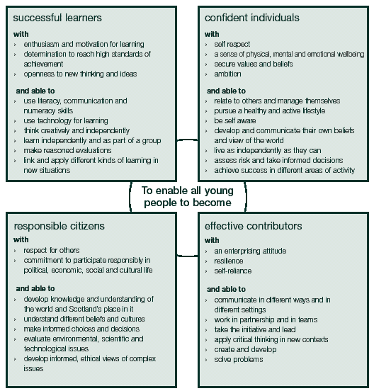
Example in Scotland : Purposes of The Curriculum
http://www.scotland.gov.uk/Publications/2004/11/20178/45862

Slide 51
Step in Balancing Primary School Teacher and Students’ duties
PIC | Duties | Solution
Teacher | Composing Syllabus | Teachers books are provided
 | Finding the appropriate books
 | Teaching some subjects in different methods | Thematic approach using one book for all subjects to be in line with the competence in using Indonesian language as tools of communication and carrier of knowledge
 | Teaching more than one subject
 | Using Indonesian language as the medium of teaching
 | Using knowledge as the motor of discussion
Student | Learning some subjects
 | Learning subjects in different methods
 | Buying books | Text books are provided by the government
 | Buying students’ worksheet

Slide 52
Steps of Strengthening Process
Process | Strengthening Characteristics
Teaching and Learning Process | Applying scientific method by observing, asking, experiencing, thinking,….
 | Using science and knowledge as a teaching and learning motor for all subjects.
 | Encourage students to find out the information, not to be informed [discovery learning]
 | Emphasizing the language competence as a tool of communication, knowledge carrier, and having competence of logical, systematic and creative thinking.
Assessment | Assess students’ level of thinking starting from low to high
 | Emphasizing deep thinking question (not merely memorizing)
 | Assess students working process, not only the product
 | Using students’ learning portfolio

Slide 53
PRIMARY SCHOOL CURRICULUM STRUCTURE
No | Komponen | I | II | III | IV | V | VI
Group A
1 | Religion and attitudes | 4 | 4 | 4 | 4 | 4 | 4
2 | Civics | 5 | 6 | 6 | 4 | 4 | 4
3 | Indonesian Language | 8 | 8 | 10 | 7 | 7 | 7
4 | Mathematics | 5 | 6 | 6 | 6 | 6 | 6
5 | Natural Science |  |  |  | 3 | 3 | 3
6 | Social Science |  |  |  | 3 | 3 | 3
Group B
7 | Art, culture & Skill (include in local curriculum*) | 4 | 4 | 4 | 5 | 5 | 5
8 | Sports (include in local curriculum*). | 4 | 4 | 4 | 4 | 4 | 4
Jumlah |  | 30 | 32 | 34 | 36 | 36 | 36
Notes:
Local Curriculum may include local language
Natural and Social Science grade I to III is integrated in other subjects

Slide 54
Junior High School Curriculum Structure
No | Komponen | VII | VIII | IX
 | Group A
1 | Religion and attitudes | 3 | 3 | 3
2 | Civics | 3 | 3 | 3
3 | Indonesian Language | 6 | 6 | 6
4 | Mathematics | 5 | 5 | 5
5 | Natural Science | 5 | 5 | 5
6 | Social Science | 4 | 4 | 4
7 | English | 4 | 4 | 4
 | Group B
8 | Art, culture & Skill (include in local curriculum*) | 3 | 3 | 3
9 | Sports (include in local curriculum*). | 3 | 3 | 3
10 | Skill (include in local curriculum*). | 2 | 2 | 2
Jumlah |  | 38 | 38 | 38
* Local Curriculum may include local language

Slide 55
Secondary School Curriculum Structure
Subjects |  | Grade
 |  | X | XI | XII
Compulsory
 | Group A
1 | Religion and Attitudes | 3 | 3 | 3
2 | Civics | 2 | 2 | 2
3 | Indonesian Language | 4 | 4 | 4
4 | Mathematics | 4 | 4 | 4
5 | Indonesian History | 2 | 2 | 2
6 | English | 2 | 2 | 2
 | Group B
7 | Art and culture (include in local curriculum*) | 2 | 2 | 2
8 | Skill and intrepeneurship (include in local curriculum*) | 2 | 2 | 2
9 | Sports (include in local curriculum*) | 3 | 3 | 3
Total of hour for compulsory group |  | 24 | 24 | 24
Subjects on Interest Group
 | Subjects on Interest for academic option (senior secondary school) | 18 | 20 | 20
 | Subjects on Interest for academic and vocation option (vocational school) | 26 | 26 | 26

Slide 56
Curriculum Structure Based on Major of Senior Secondary School
MATA PELAJARAN |  |  | Kelas
 |  |  | X | XI | XII
Group A and B (Compulsory) |  |  | 24 | 24 | 24
Mathematics and Natural Science
I | 1 | Mathematics | 3 | 4 | 4
 | 2 | Bbiology | 3 | 4 | 4
 | 3 | Physics | 3 | 4 | 4
 | 4 | Chemical | 3 | 4 | 4
Social
II | 1 | Geography | 3 | 4 | 4
 | 2 | History | 3 | 4 | 4
 | 3 | Sociology& Anthropology | 3 | 4 | 4
 | 4 | Economics | 3 | 4 | 4
Language
III | 1 | Indonesian Language | 3 | 4 | 4
 | 2 | English | 3 | 4 | 4
 | 3 | Other language and art | 3 | 4 | 4
 | 4 | Anthropology | 3 | 4 | 4
Optional Subject and enrichment
 | Optional for enrichment and across major |  | 6 | 4 | 4
Total hour provided each week |  |  | 60 | 72 | 72
Total hour to be taken each week |  |  | 42 | 44 | 44

Slide 57
SUBJECTS |  | GRADE
 |  | X | XI | XII
Group A (Compulsory)
1. | Religion and Attitude | 3 | 3 | 3
2. | Civics | 2 | 2 | 2
3. | Indonesian Language | 4 | 4 | 4
4. | Mathematics | 4 | 4 | 4
5. | Indonesian History | 2 | 2 | 2
6. | English | 2 | 2 | 2
Group B (Compulsory)
7. | Art and Culture | 2 | 2 | 2
8. | Skill and entrepreneurship | 2 | 2 | 2
9. | Sports | 3 | 3 | 3
Total Number of Group A and B |  | 24 | 24 | 24
Group C (Major)
Academic and vocational Major Subjects |  | 24 | 24 | 24
TOTAL |  | 48 | 48 | 48

Slide 58
The Importance of Thematic Integrated
Educators and researchers believe that the students see the world as a whole are connected, instead of loose fragments and separate. [Ministry of Education of Alberta, Canada]
Although primary school is designed by using subjects with different definitions of competence with each other [as in the curriculum 2004 and 2006], certain subject will produce the same outputs with others. [Ministry of Education of Alberta, Canada]
Those different subjects are close related to one another [as shown in the formulation of basic competence on curriculum 2006]. Thus, the integration of content on a variety of subject is the direction for students to be able to create linkages between the subjects will strengthen student learning. [Department of Education Alberta, Canada

Slide 59
Research on Integrated Curriculum
Integrated curriculum as a model of an integrated thematic approach is one of the learning approach in which competences [knowledge, skills, and attitudes] from a variety of subjects are combined to formulate a deeper and fundamental understanding on what should be mastered by the student.
Some educational researchers have emphasized the importance of an integrated learning, such as Susan Drake, Heidi Hayes Jacobs, James Beane and Gordon Vars, etc. stating that the curriculum is relevant, integrated, cross-disciplinary, holistic, and various other terms have the same meaning
James Beane also emphasizes “When we are confronted in real life with a compelling problem or puzzling situation, we don’t ask which part is mathematics, which part is science, which part is history, and so on. Instead we draw on or seek out knowledge and skill from any and all sources that might be helpful”

Slide 60
Benefit of Thematic Integrated
For elementary schools applying class teacher-system, thematic integrative will give some benefits, such as:
Fleksibility in time management and consideration of the students needs.
Brings together student learning, convergence understanding gained, while preventing the occurrence of inconsistencies between subjects
Reflecting the real world encountered by students at home and surrounding.
In line with the way children are thinking; ,based on research the brain support pedagogic and physiologic theory that children receive many thins and manage and resume it. Thus, teaching holistic and integrated is in line with the way children brain processes the information.

Slide 61
GRADE I BOOKS
Grade |  |  | Book Title
GRADE I | STUDENT | THEMATIC | 1. About Me
 |  |  | 2. My Hobby
 |  |  | 3. My Activities
 |  |  | 4. My Family
 |  |  | 5. My Experience
 |  |  | 6. Clean, Healthy Surroundings
 |  |  | 7. Things, Animals and Trees in My Surrounding
 |  |  | 8. Nutural Events
 |  | RELIGION | 9. Islam and Attitute
 |  |  | 10.Christian and Attitute
 |  |  | 11. Catholic and Attitute
 |  |  | 12. Hindu and Attitute
 |  |  | 13.Budhism and Attitute
 |  |  | 14. Kong Hucu and Attitute
 | TEACHER | Teachers’ Books are completed with : Guide in teaching and learning process Guide in Assessment Guide in Remidial Enrichment Materials Interaction Guide for Teacher, Students and Parents

Slide 62
GRADE IV BOOKS
Grade |  |  | Book Title
GRADE IV | STUDENT | THEMATIC | 1. The Beauty of Togetherness
 |  |  | 2. Energy Saving
 |  |  | 3. Care about other Creature
 |  |  | 4. Sharing Jobs
 |  |  | 5. Honouring the Herroes
 |  |  | 6. The Beauty of My country
 |  |  | 7. My Idea
 |  |  | 8. My Regon
 |  |  | 9. Healthy and Nutritious Foods
 |  | RELIGION | 9. Islam and Attitute
 |  |  | 10.Christian and Attitute
 |  |  | 11. Catholic and Attitute
 |  |  | 12. Hindu and Attitute
 |  |  | 13.Budhism and Attitute
 |  |  | 14. Kong Hucu and Attitute
 | TEACHER | Teachers’ Books are completed with : Guide in teaching and learning process Guide in Assessment Guide in Remidial Enrichment Materials Interaction Guide for Teacher, Students and Parents

Slide 63
GRADE VII BOOKS
Kelas |  |  | Judul Buku
GRADE VII | STUDENTS | SUBJECTS | 1. PPKn
 |  |  | 2. Bahasa Indonesia
 |  |  | 3. Matematika
 |  |  | 4. IPA
 |  |  | 5. IPS
 |  |  | 6. Bahasa Inggris
 |  |  | 7. Penjasorkes
 |  |  | 8. Seni Budaya
 |  |  | 9. Prakarya
 |  | RELIGION | 9. Islam and Attitute
 |  |  | 10.Christian and Attitute
 |  |  | 11. Catholic and Attitute
 |  |  | 12. Hindu and Attitute
 |  |  | 13.Budhism and Attitute
 |  |  | 14. Kong Hucu and Attitute
 | TEACHERS | Teachers’ Books are completed with : Guide in teaching and learning process Guide in Assessment Guide in Remidial Enrichment Materials Interaction Guide for Teacher, Students and Parents

Slide 64
CUMPULSORY SUBJECTS BOOKS GRADE X
Grade |  |  | Book Title
GRADE X | STUDENTS | SUBJECTS | 1. Civics
 |  |  | 2. Indonesian Language (Priority)
 |  |  | 3. Mathematics (Priority)
 |  |  | 4. Indonesian History (Priority)
 |  |  | 5. English
 |  |  | 6. Sports
 |  |  | 7. Art and Culture
 |  |  | 8. Skill
 |  | RELIGION | 9. Islam and Attitute
 |  |  | 10.Christian and Attitute
 |  |  | 11. Catholic and Attitute
 |  |  | 12. Hindu and Attitute
 |  |  | 13.Budhism and Attitute
 |  |  | 14. Kong Hucu and Attitute
 | TEACHERS | Teachers’ Books are completed with : Guide in teaching and learning process Guide in Assessment Guide in Remidial Enrichment Materials Interaction Guide for Teacher, Students and Parents
Catatan : Books provided by the Government are the compulsory subjects books. In 2013 the provided books are Indonesian Language, mathematics, and Indonesian History

Slide 65
Thank you

Slide 66
Teacher Training?

Slide 67

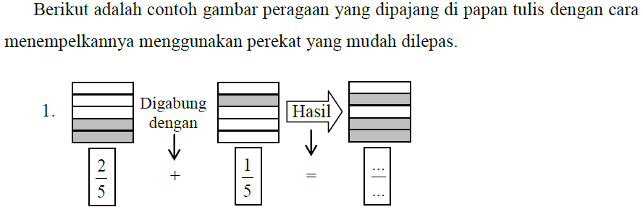
Sumber: Marsudi R
DI DEKOLAH DASAR

Slide 68
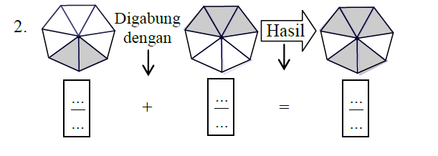
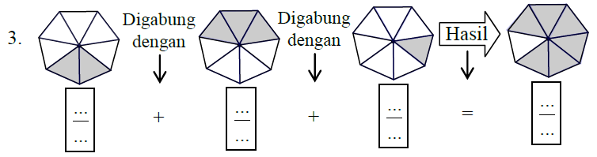

Slide 69
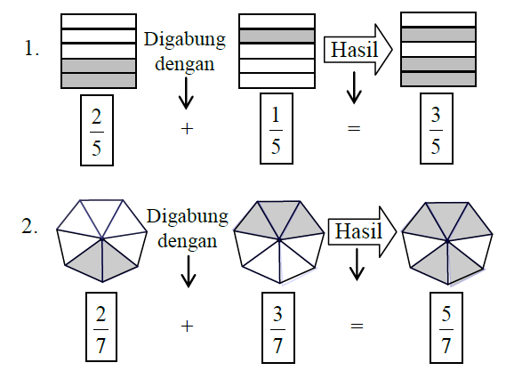

Slide 70
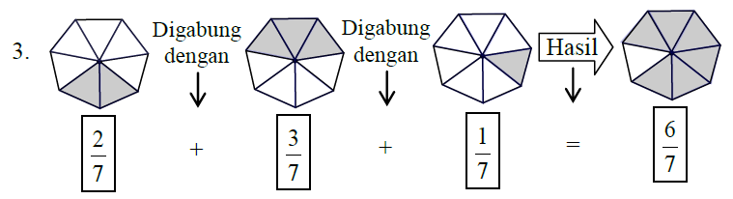

Slide 71
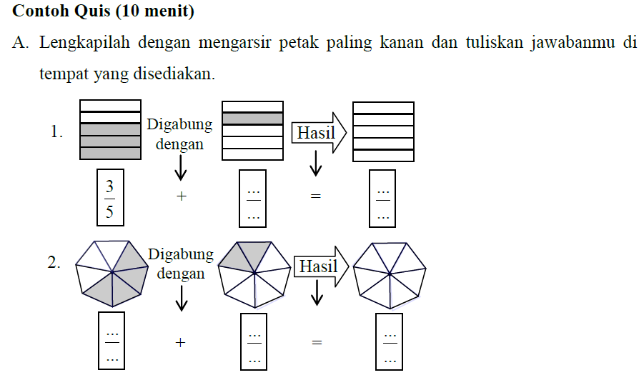

Slide 72
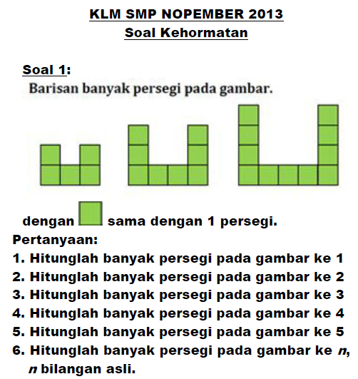
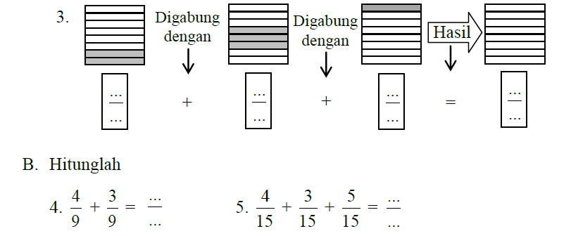

Slide 73
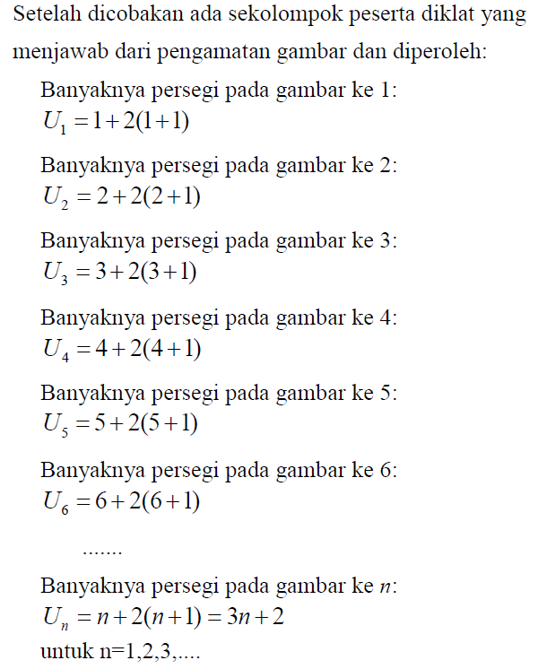

Slide 74
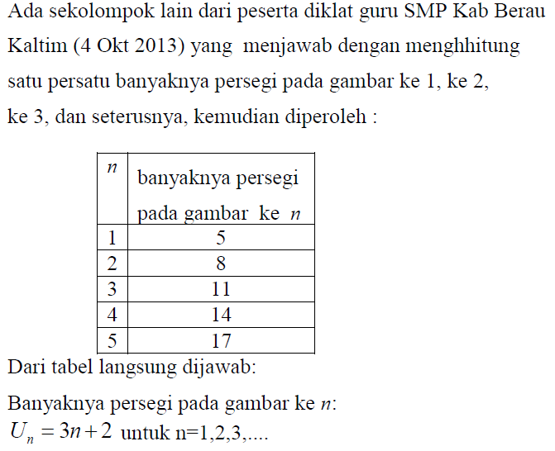

Slide 75
Soal No. 1,, dalam KLM 2013 di PPPPTK Matematika, telah dikerjakan oleh siswa Kelas I SMPN ... Purwokerto hanya dalam waktu 3 menit.

Slide 76
Problem 2: Given the sequence of pictures:
If = 1, then
(a). How many squares in the 1st picture
(b). How many squares in the 2nd picture
(c). How many squares in the 3rd pucture
(d). How many squares in the 4th picture
(e). How many squares in the 5th picture
(f). How many squares in the n th picture

Slide 77
Problem 3: Given the sequence of pictures:
If = 1, then
(a). How many squares in the 1st picture
(b). How many squares in the 2nd picture
(c). How many squares in the 3rd pucture
(d). How many squares in the 4th picture
(e). How many squares in the 5th picture
(f). How many squares in the n th picture

Slide 78
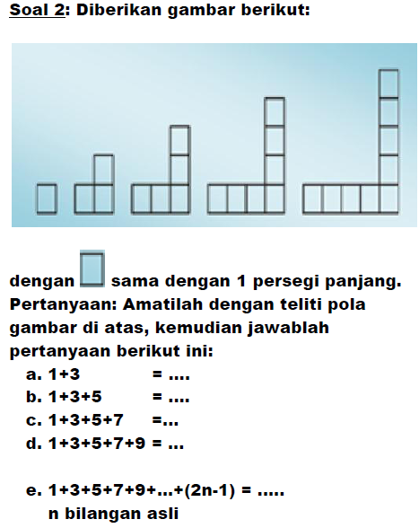

Slide 80
Soal No. 2, dalam KLM 2013 di PPPPTK Matematika, telah dikerjakan oleh siswa Kelas I SMPN ... Purwokerto hanya dalam waktu 3 menit.

Slide 81
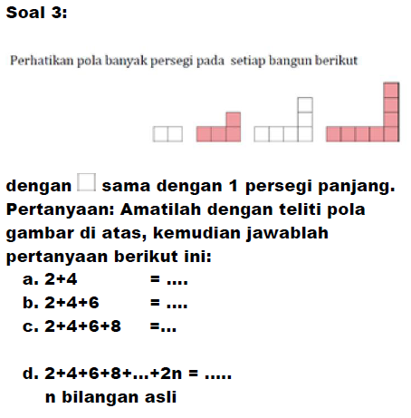

Slide 85
Soal No. 1,, dalam KLM 2013 di PPPPTK Matematika, telah dikerjakan oleh siswa Kelas I SMPN ... Purwokerto hanya dalam waktu 3 menit.

Slide 87
Soal No. 2, dalam KLM 2013 di PPPPTK Matematika, telah dikerjakan oleh siswa Kelas I SMPN ... Purwokerto hanya dalam waktu 3 menit.

